Slide 1
Pin and Password Security
Michael Amista’ - Gabriel Rovesti
December 7th 2023
Advanced Topics in Computer Network and Security
2023-2024

Slide 2
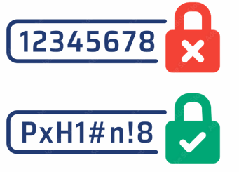
PIN sounds good… but is it?
Easy and simple…
But secure?

Slide 3
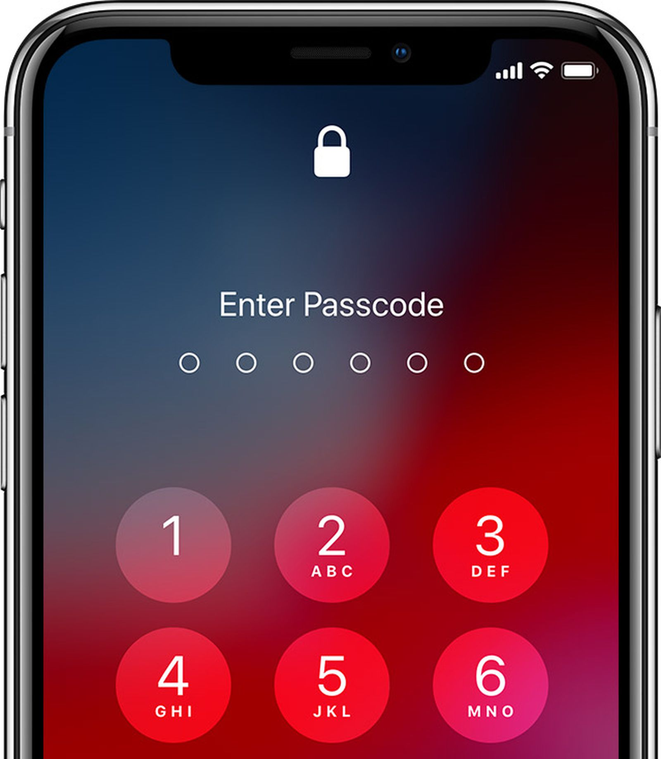
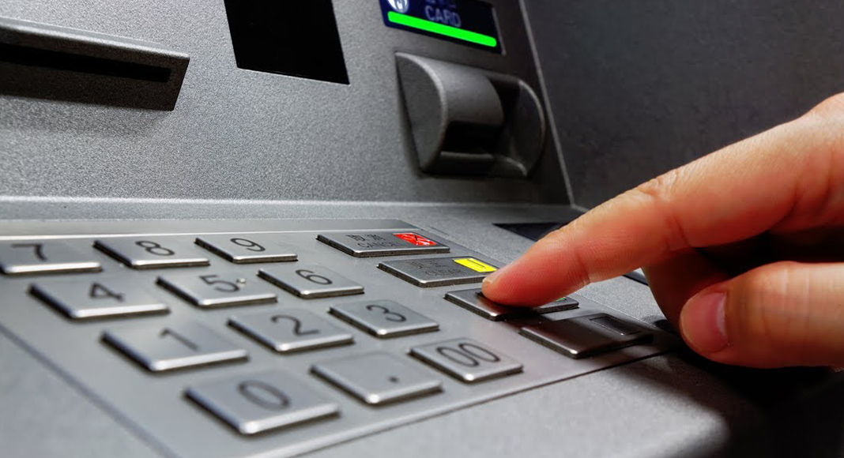
Where are PINs used?
ATMs and PoS
Smartphones

Slide 4
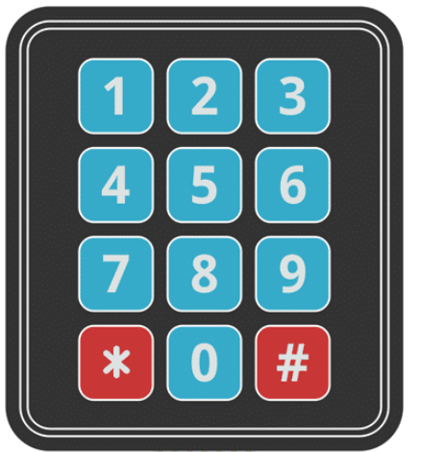

How are ATM PINs exploited?
Non-acoustic
Acoustic

Slide 5
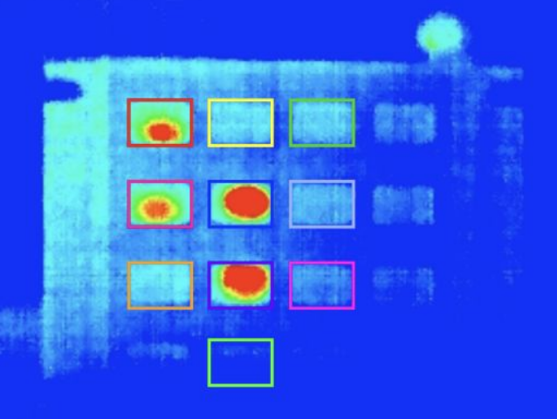
How to track and study PINs?
Non-acoustic
While the user is typing the password
Recover keystrokes by electromagnetic emanations
Observation via a thermal camera to identify key presses on the keypad

Slide 6
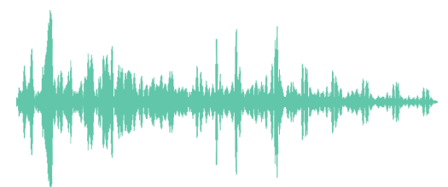
How to track and study PINs?
Acoustic
Each key emits a characteristic sound
Able to construct a dictionary attack to bruteforce and reconstruct words
Multiple microphones to triangulate the keys positions
Alternatives: SSH traffic and video →
measure the timing between presses works better!

Slide 7
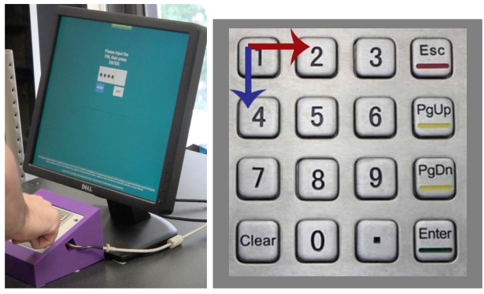
Keystroke Timing
Measures the distance between consecutive keystrokes of subsequent keys
The adversary can infer keystroke timings by using audio when the user is typing the PIN
Filter timestamps of keys pressed from keypad sound normalizing the samples
Timing is based on observation (video)

Slide 8
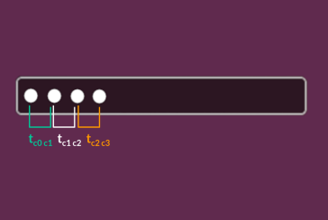
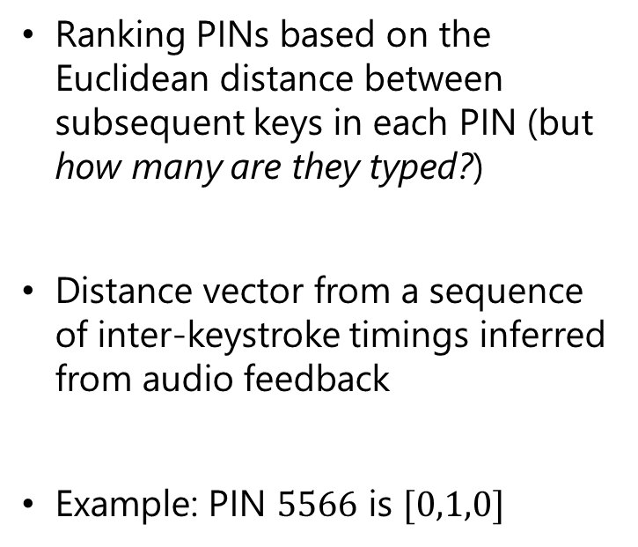
Keystroke Timing
Ranking PINs based on the Euclidean distance between subsequent keys in each PIN (but how many are they typed?)
Distance vector from a sequence of inter-keystroke timings inferred from audio feedback
Example: PIN $5566$ is $[0,1,0]$

Slide 9
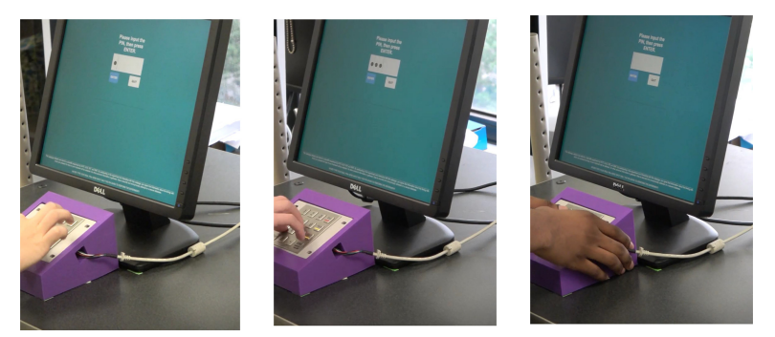
Typing Behavior
The adversary can typically observe (video) whether the user is typing with:
one finger (single typists)
more fingers (multi-finger typists)
We can combine thermal camera (video) with keystroke timing (audio)

Slide 10
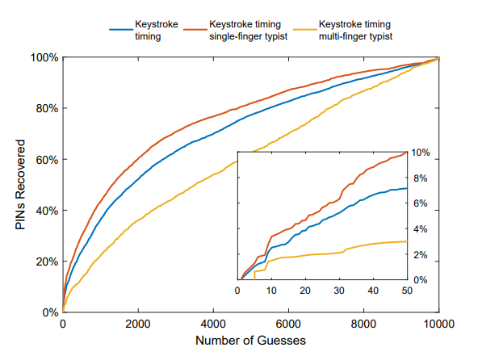
Typing Behavior + Keystroke Timing
Single-finger typists:
less PINs – more timing
Two-finger typists:
more PINs – less timing
The inter-keystroke timing (when) is not representative of the Euclidean distance (how many)….
…which means higher guesses over single-finger compared to multi-finger!

Slide 11
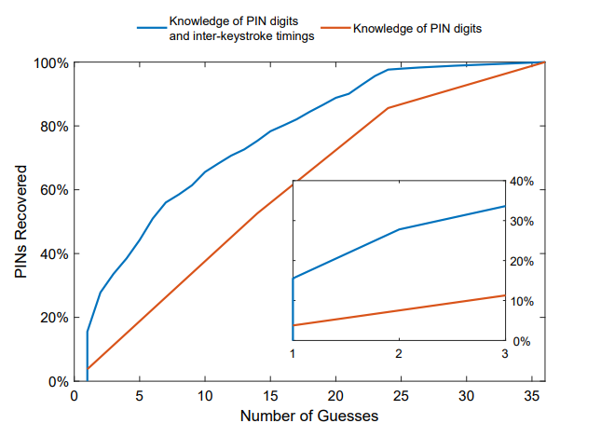
Knowledge of which keys have been pressed
The adversary may have visibility of the keypad in how the user moves his hand via a thermal camera
Knowledge of one digit alone reduces the search space by a linear factor (first or last) over the remaining digits
The keystroke-timing combined with knowledge of keys lead to a high PIN recover rate

Slide 12
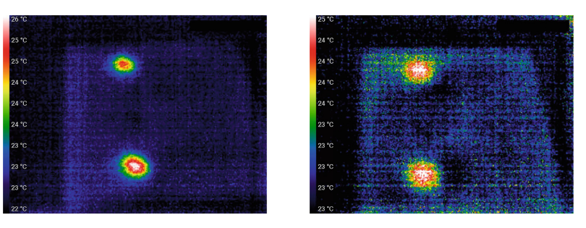
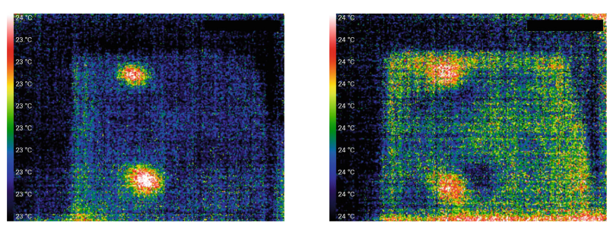
How much time to get the keys pressed?

Slide 13
Analysis of PINs Guessing Probability
Choosing PINs uniformly at random from the entire PIN space is not the best strategy
The inter-keystroke timing, combined with other sources of information, can lead to higher PINs recovery rate even with same guessing probability thank to audio feedback
Keystroke timing + knowledge of first/last digit = x14
Keystroke timing + observation of keys = +15%
Strong correlation between Euclidean distance (which keys) and inter-keystroke timings (how many) lead, combined with previous ones, to better results

Slide 14
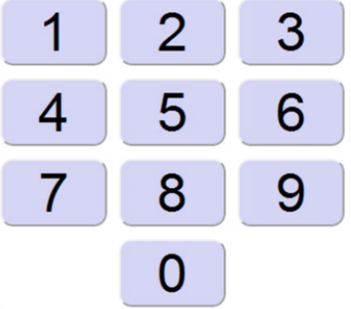
PIN Selection Policies
We said that PINs must be easy to remember….
….but how much can we trust users?
We must combine:
usability – easy to remember
security – randomly distributed and difficult to guess
PINs should have:
totally different numbers and using last numerical digits (e.g. 7,8,9)
different from things easy-to-remember (e.g. birthdays, events, etc.)
security-by-design (a policy which improves the safety without forcing the user to remember something difficult)

Slide 15
How PINs are distributed in the real world
Occurrence frequency of the PINs (Power law distribution)
First digits are pressed more than others
Easier for an attacker to guess the first digit than the other digits
PINs generated from dates and years
A good portion of selected PINs are made like this
PINs generated from arithmetic operations
Some users combine simple things (e.g. addition/multiplication, etc.)
Just a minority over the others
PINs with close proximity
Consecutive numbers are more selected given they’re easy to use
Another good portion of PINs are like this

Slide 16
How PINs can be more effectively chosen
How to balance easy-to-remember/hard-to-master in PINs?
Enforce selection policies (secure but not too strict)
Application of said policies in everyday life (e.g. locking mobiles)
PINs usable safely and simply in all real-life contexts
How to balance easy-to-remember/hard-to-master in PINs?
4-free: 4-digit PIN without any restriction
4-short: 4-digit PIN where the 200 most popular PINs were not allowed
4-long: same rules as 4-short + without any consecutive number
6-free: 6-digit PIN without any restriction
6-long: 6-digit PIN without any consecutive number
Scale of easy-to-remember (1 = “very easy” up to 5 = “very difficult”)

Slide 17

How PINs can be chosen and selected
The study gave the following results:
PINs tend to be chosen between the most popular ones
remembrance is worse (4-short vs 4-free)
PINs tend to be chosen with consecutive numbers more
4-long (more secure) vs 4-short (less secure) = harder for users
This holds even In longer PINs
remembrance is worse (6-free vs 6-long)
Good compromise: choose 4-short PINs over 4-free

Slide 18
How PINs can be chosen and selected
In conclusion:
Entropy is higher on longer PINs or longer subsequences
Odd numbers are usually less frequent
It can be useful to analyze more geographical areas and PINs databases
It would be better to:
Choose 4-short PINs over 4-free (note: from this study onwards)
Suitable compromise between security and usability
Useful to enforce a PIN blacklists policy (e.g. avoiding popular PINs)
Impose more different chars, easy length and easy words without enforcing the users
Notes:
Suitable compromise between security and usability → mentioned in the first point at oral

Slide 19


Thanks for the attention... but now it’s your turn!

